Slide 1
Switching
Dr. R. Prashanth

Slide 2
Introduction
This technique of transferring the information from one computer node to another node is known as switching.
Switching in a computer network is achieved by using switches.
Network switches operate at layer 2 (Data link layer) in the OSI model.
Switches are used to forward the packets based on MAC addresses.
It is operated in full duplex mode.

Slide 3
Why is Switching Concept required?
Collision: Collision is the effect that occurs when more than one device transmits the message over the same physical media, and they collide with each other. To overcome this problem, switching technology is implemented so that packets do not collide with each other.

Slide 4
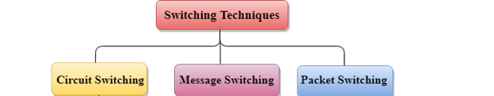
Classification Of Switching Techniques

Slide 5
Circuit Switching
Circuit switching is a switching technique that establishes a dedicated path between sender and receiver.
In the Circuit Switching Technique, once the connection is established then the dedicated path will remain to exist until the connection is terminated.
In case of circuit switching technique, when any user wants to send the data, voice, video, a request signal is sent to the receiver then the receiver sends back the acknowledgment to ensure the availability of the dedicated path.
Circuit switching is used in public telephone network. It is used for voice transmission.

Slide 6
Message Switching
Message Switching is a switching technique in which a message is transferred as a complete unit and routed through intermediate nodes at which it is stored and forwarded.
In Message Switching technique, there is no establishment of a dedicated path between the sender and receiver.

Slide 7
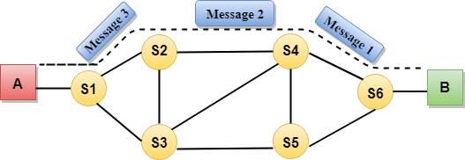
Communication through circuit switching has 3 phases
Circuit establishment
Data transfer
Circuit Disconnect
Disadvantages Of Circuit Switching:
Once the dedicated path is established, the only delay occurs in the speed of data transmission.

Slide 8
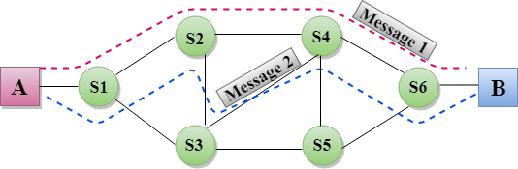
Disadvantages Of Message Switching
The message switches must be equipped with sufficient storage to enable them to store the messages until the message is forwarded.

Slide 9
Packet Switching
The packet switching is a switching technique in which the message is divided into smaller pieces, and they are sent individually.
The message splits into smaller pieces known as packets .
Packets will travel across the network, taking the shortest path as possible.
All the packets are reassembled at the receiving end in correct order.
If any packet is missing or corrupted, then the message will be sent to resend the message.
If the correct order of the packets is reached, then the acknowledgment message will be sent.

Slide 10
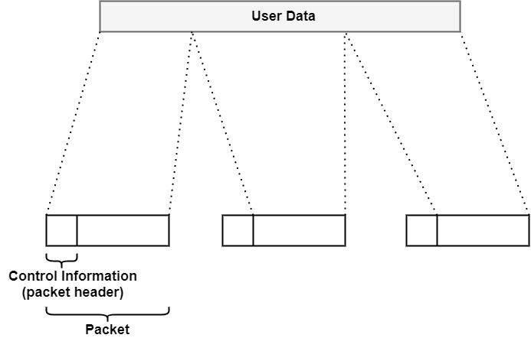

Slide 11
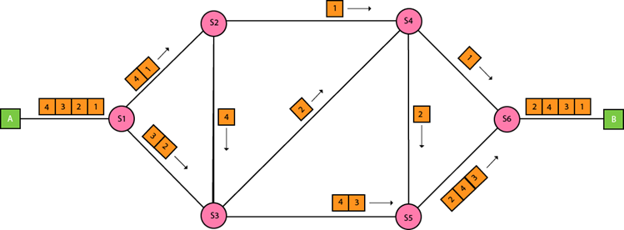
Packet Switching

Slide 12
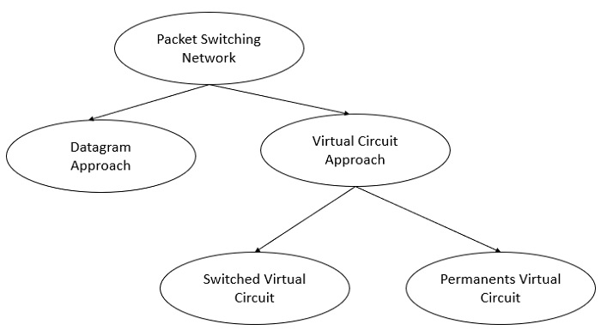
Approaches Of Packet Switching:
Datagram Packet switching:
Virtual Circuit Switching

Slide 13
Datagram approach
In a datagram packet switched network the data packets follow their own path to send the packets between the source and destination.
During data transmission, after each packet reaches a node, then it decides which path the packet needs to follow the next.
This dynamic decision making of datagram packet switched networks improves the performance of data transmission.

Slide 14
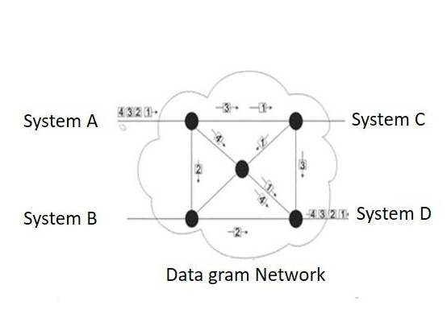
In the besides diagram the datagram approach is used to deliver four packets from station A to station D.
All the four packets belong to the same message but they may travel via different paths to reach the destination i.e. station D.

Slide 15
Advantages
The advantages of the datagram packet switching are explained below It provides greater flexibility
It performs fast re-routing of data packets at the time of network congestion or failure.
Disadvantages
The disadvantages of the datagram packet switching are explained below −
Each packet has to decide its own dedicated path.
If large group of packets assembled at the same destination the network has to examine each packets that travels through the network node individually and it has to determine next path of each packets
This leads to inefficiency and wastage of time.

Slide 16
Virtual circuit switching
It is a network where a virtual connection is established between source and the destination.
Through this network, packets will be transferred during any call. The path established between two points appears as a dedicated physical circuit.
Therefore, it is called a virtual circuit. It is a type of packet switching.
It is a connection-oriented service, where the first packet goes and reserves the resources for the subsequent packets.

Slide 17
Virtual Circuit is the computer network providing connection-oriented service.
It is a connection-oriented network. In virtual circuit resource are reserve for the time interval of data transmission between two nodes.
This network is a highly reliable medium of transfer. Virtual circuits are costly to implement.
Virtual Circuit Identifier (VCID or VCI) is an identifier or label on any virtual circuit in a computer network that indicates where a data unit has to travel over the network

Slide 18
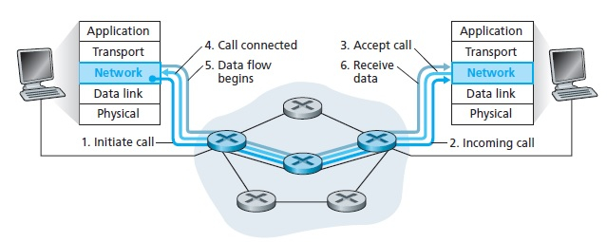

Slide 19
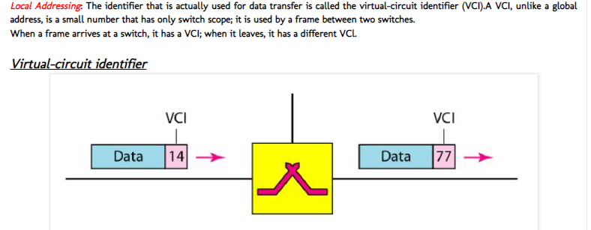
Addressing
Two types of addressing are involved: global and local.

Slide 20
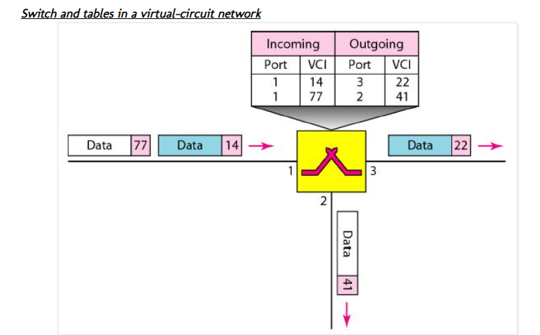

Slide 21
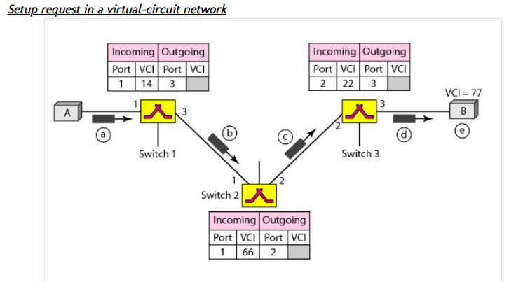
Three phase
A packet has to go from source to destination in three phases in VC, then

Slide 22
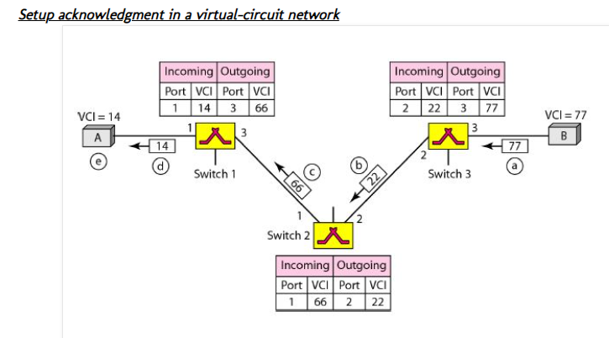

Slide 23
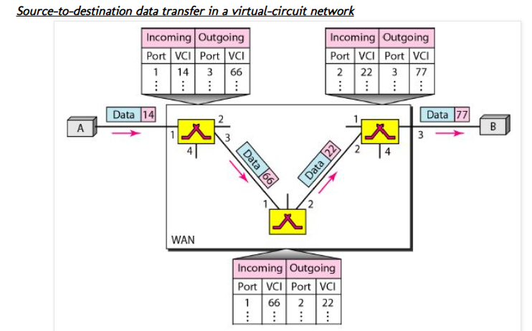

Slide 24
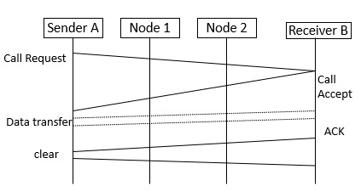
Flow diagram

Slide 25
Steps
Step 1 − Sender A establishes a call request connection to connect with the receiver.
Step 2 − Receiver B establishes a call accepting connection to connect with sender.
Step 3 − Data will be transferred whenever the router is established.
Step 4 − Node 1 and Node 2 are intermediate nodes between sender and receiver, the data will be transferred by connecting two nodes virtually.
Step 5 − After transmitting the data, an ACK will be sent by the receiver by saying a message is received.
Step 6 − A clear signal will be sent if the user wants to terminate the connection.

Slide 26
Advantages
The advantages of virtual circuit are as follows −
Packets are delivered in the same order as they all follow the same route between the source & the destination.
The overhead is smaller as full address is not required on each packet as they all follow the same established path.
The connection is more reliable as it is one to one connection.
Less chances of data loss.

Slide 27
Disadvantages
The disadvantages of virtual circuit are as follows −
The switching equipment should be powerful.
Re-establishment of the network is difficult as if there is any failure. All calls need to be re-established.

